Slide 1

BASIC ELECTRICAL AND ELECTRONICS ENGINEERING
Course Code: CSE1002
SCHOOL OF COMPUTER SCIENCE ENGINEERING AND APPLICATIONS
Mrunmayee Rahate
Assistant Professor, DYPIU

Slide 2
Module 1: Fundamentals of Electrical Circuits
Lecture 2:
Circuit Elements: Resistor, Inductor, Capacitor; Voltage and Current Sources (Independent and Dependent)

Slide 3
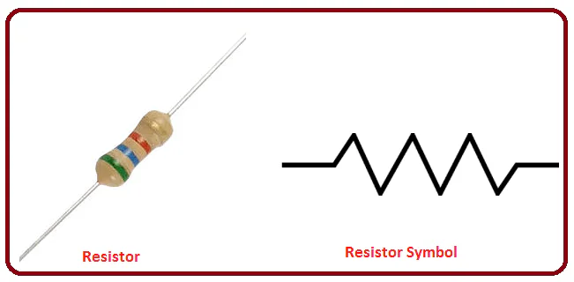
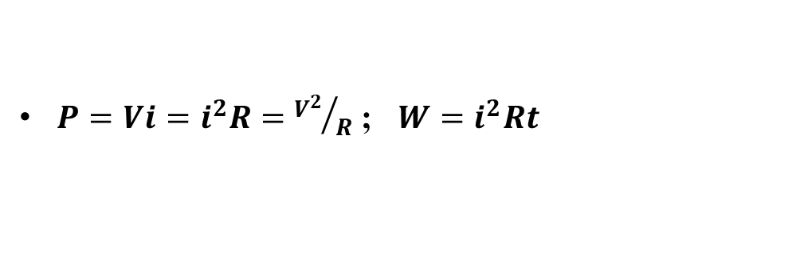
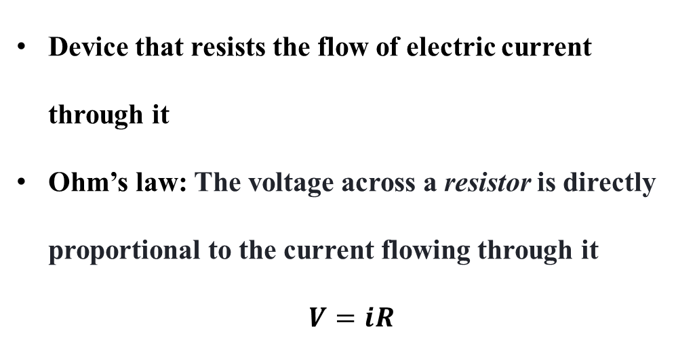
Resistor
+
V
-
i
>
R
V
Device that resists the flow of electric current through it
Ohm’s law: The voltage across a resistor is directly proportional to the current flowing through it
$$V=iR$$
R
i
$P=Vi=i^{2}R={V^{2}}/R$ ; $W=i^{2}Rt$
Notes:
A resistor is a device that resists the flow of electric current through it. It limits or controls the amount of current passing in an electrical circuit by providing resistance.
Physical Appearance and Symbol
The image shows a common resistor, which is a small cylindrical component with coloured bands indicating its resistance value.
The resistor symbol in circuit diagrams is a zigzag line representing resistance.
The terminals are marked with a positive (+) and negative (-) side, and current i flows through it.
Voltage across the resistor is V, and resistance is denoted by R.
Ohm’s Law
The fundamental principle governing resistors is Ohm’s Law, which states:
$V=iR$
V is the voltage across the resistor (in volts),
i is the current flowing through the resistor (in amperes),
R is the resistance (in ohms, Ω\Omega).
This means that the voltage drop across a resistor is directly proportional to the current flowing through it, with the proportionality constant being the resistance.
Power and Energy Dissipation
A resistor opposes the flow of current, converting electrical energy into heat.
The power P (watts (W)) dissipated in a resistor is:
$P=Vi=i^{2}R={V^{2}}/R$
This power is the rate at which energy is converted into heat.
The total energy W (joules (J)) dissipated over time t is:
$W=i^{2}Rt$
This equation shows that energy dissipation depends on the square of current, resistance, and time.
Graphical Representation
The graph shows a linear relationship between voltage V and current i.
The slope of the line corresponds to the resistance R.
This linearity indicates that the resistor obeys Ohm’s law, with voltage increasing proportionally to current.

Slide 4
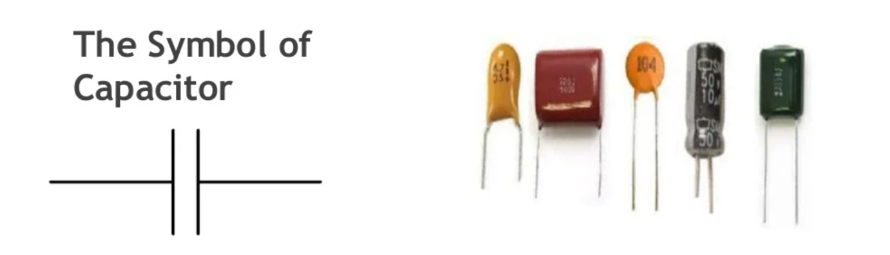

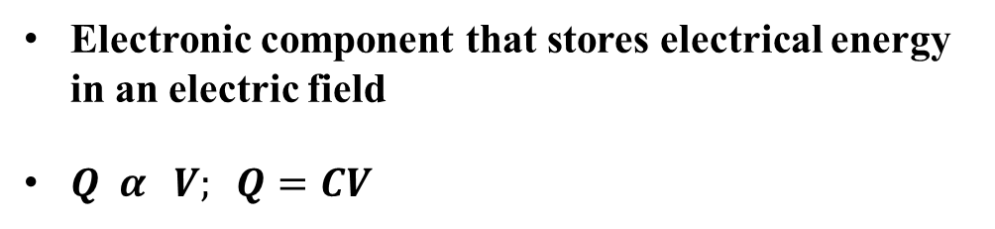
Capacitor
+
V
-
i
>
C
Q
Electronic component that stores electrical energy in an electric field
$Q α V; Q=CV$
$i=\frac{dQ}{dt}=C\frac{dV}{dt}$
C
$P=Vi=CV\frac{dV}{dt}$
$W=\int_{v=0}^{v=V}{Pdt}=C\int_{0}^{V}{Vdv}=\frac{1}{2}CV^{2}$
V
Notes:
A capacitor is an electronic component that stores electrical energy in an electric field. It consists of two conductive plates separated by an insulating material called the dielectric. When voltage is applied, it stores energy by accumulating opposite charges on each plate.
Symbol and Physical Form
The symbol of a capacitor is two parallel lines (plates), often with the positive (+) and negative (-) terminals marked.
The image shows various types of capacitors (ceramic, electrolytic, film, etc.) with different shapes and sizes, but all serve the same fundamental function.
Mathematical Explanation and Equations
Charge-Voltage Relationship:
$Q α V$
$Q=CV$
Q is the charge stored (in coulombs),
V is the voltage across the capacitor (in volts),
C is the capacitance (in farads), which depends on the geometry and material of the capacitor.
2.Current-Voltage Relationship:
Current i through the capacitor is the rate of change of charge:
$i=\frac{dQ}{dt}=C\frac{dV}{dt}$
This means the current through a capacitor is proportional to the rate of change of voltage across it.
3.Power:
Power delivered to the capacitor is:
$P=Vi=CV\frac{dV}{dt}$
4.Energy Stored in Capacitor:
The energy W stored in the capacitor (energy stored in the electric field between the plates) can be found by integrating power over time.
$W=\frac{1}{2}CV^{2}$
Graphical Representation
The graph shows the relationship between charge Q and voltage V.
The red line indicates a linear relationship, meaning charge is directly proportional to voltage.
The slope of this line corresponds to the capacitance C.

Slide 5
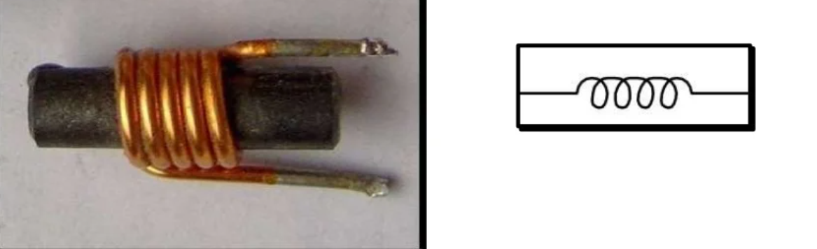

Inductor
i
V
-
+
>
L
ϕ
Passive electrical component that stores energy in the form of a magnetic field when electrical current flows through it
L
$φ α i ; φ=L$ i
$V=\frac{dφ}{dt}=L\frac{di}{dt}$
$W=\int_{i=0}^{i=I}{Pdt}=L\int_{0}^{I}{idi}=\frac{1}{2}LI^{2}$
i
$P=Vi=Li\frac{di}{dt}$
Notes:
An inductor is a passive electrical component that stores energy in the form of a magnetic field when electrical current flows through it.
It resists changes in current, unlike a capacitor which resists changes in voltage.
Inductors are commonly made by winding a wire into a coil.
The core material (air, iron, or ferrite) affects the inductor's properties.
Key Relationships and Equations
Flux–Current Relationship
The magnetic flux linked with the inductor is directly proportional to the current flowing through it.
$φ α i$
$φ=L$ i
ϕ: Magnetic flux (in Weber, Wb)
i: Current through the inductor (A)
L: Inductance (H)
2. Induced Voltage (Faraday’s Law)
$V=\frac{dφ}{dt}=L\frac{di}{dt}$
This is Faraday’s Law of Electromagnetic Induction.
A changing current produces a changing magnetic field, which induces a voltage that opposes the change in current (Lenz's Law).
This is why inductors resist sudden changes in current.
3. Energy Stored in an Inductor
Energy is stored gradually as the current builds up, and released when current decreases.
4. Power in an Inductor
Power delivered to the inductor depends on both the current and the rate of change of current.
If current is constant, no power is consumed — the inductor acts like a short circuit in steady-state DC.
Graphical Representation
The graph shows a linear relationship between magnetic flux ϕ and current i.
The slope of the line is inductance L.

Slide 6
CLASSIFICATION OF SOURCES
Sources
Independent
Dependent
Voltage source
Current source
Current controlled Current source(CCCS)
Current controlled Voltage source(CCVS)
Voltage controlled Voltage source(VCVS)
Voltage controlled Current source(VCCS)

Slide 7
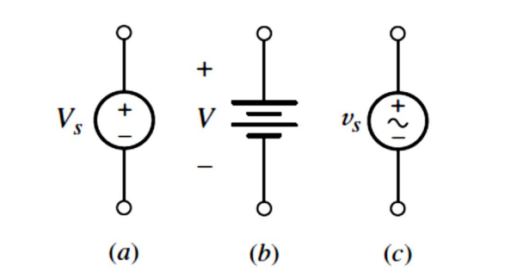
Independent Vs. Dependent Sources
Sources in which the voltage is completely independent of the current, or the current is completely independent of the voltage; these are termed independent sources.
Special kinds of sources for which either the source voltage or current depends upon a current or voltage elsewhere in the circuit; such sources are referred to as dependent sources.
Independent Voltage Sources
(a) DC voltage source
(b) battery symbol
(c) AC voltage source symbol
An independent voltage source is characterized by a terminal voltage which is completely independent of the current through it.

Slide 8

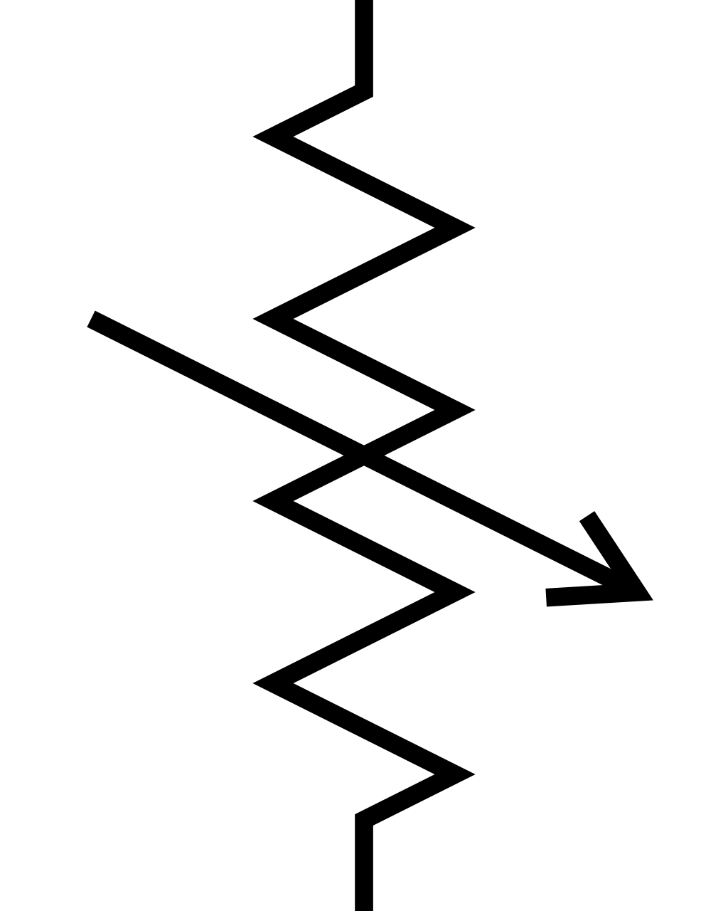
Independent Voltage Sources
The independent voltage source is an ideal source and does not represent exactly any real physical device.
Because the ideal source could theoretically deliver an infinite amount of energy from its terminals (delivery of infinite current at a particular constant voltage).
This idealized voltage source does, however, furnish a reasonable approximation to several practical voltage sources.
Ideal Vs. Practical Voltage Sources
r
+
V_{T}
-
V_{T}
ir
i
Notes:
Independent Voltage Sources
An independent voltage source is an ideal source that provides a constant voltage regardless of the current drawn from it. It is a theoretical concept and does not represent any real physical device exactly. The ideal voltage source can, in theory, supply an infinite amount of energy because it maintains a constant voltage at its terminals regardless of the current flowing through it. This means it can deliver an infinite current if required without the voltage dropping, which is practically impossible.
Approximation to Real Sources:
Even though ideal voltage sources don't exist, they serve as a reasonable approximation for many practical voltage sources like batteries or power supplies. Real voltage sources behave somewhat like ideal sources but with limitations.
Ideal Vs. Practical Voltage Sources
Ideal Voltage Source:
Has zero internal resistance (denoted as r = 0 Ω).
The voltage across its terminals remains constant regardless of the current drawn.
On the graph, the voltage VT remains flat even as current i changes.
Practical Voltage Source:
Has some internal resistance r, which is inherent in the physical construction.
The terminal voltage decreases as the current increases because of this internal resistance.
Terminal voltage V in a practical source can be expressed as:
V=VT−ir
where:
VT = The no-load voltage (voltage when no current is drawn),
i = Current drawn,
r = Internal resistance.
Explanation of Circuit and Graph
The circuit diagram on the left shows a voltage source VT with an internal resistance r connected in series to a load resistor.
The graph on the right plots the terminal voltage V against the current i.
The dashed red line represents the practical voltage source behavior: voltage decreases as current increases.
The solid line (horizontal) represents the ideal voltage source, maintaining constant voltage regardless of the current..

Slide 9
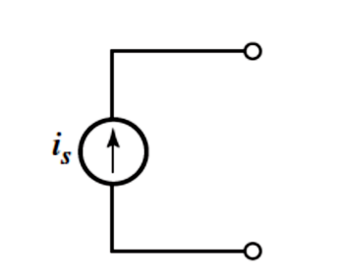
Independent Current Sources
For independent current source, the current through the element is completely independent of the voltage across it.
Circuit symbol for the independent current source.
Ideal Vs. Practical Current Sources
I_{T}
+
V
-
I_{T}
V/r
r
v
Notes:
Independent Current Sources
An independent current source is an element that provides a constant current ‘is’ regardless of the voltage across it. The voltage across an ideal current source can vary to whatever value is necessary to maintain that current. This means the current through the source is completely independent of the voltage applied across its terminals.
The symbol of an independent current source is a circle with an arrow inside, indicating the direction of current ‘is’. This symbol represents that the current is fixed and supplied continuously in the specified direction.
Ideal Vs. Practical Current Sources
Ideal Current Source:
It supplies a constant current IT no matter what the voltage across it is. The internal resistance r is infinite, meaning it acts like an open circuit internally for voltage.
In the graph of current (I) vs. voltage (V):
The current stays constant at IT regardless of V.
This is shown as a vertical line on the graph (current fixed, voltage varies).
Practical Current Source:
A real current source has some internal resistance r in parallel. This means the current supplied by the source is not perfectly constant and varies slightly with voltage. The practical current source can be modelled as an ideal current source IT in parallel with a resistor r. Voltage across this source is not infinite; it depends on the load and internal resistance. The current through the source decreases slightly as voltage increases due to the internal resistance.
On the graph:
The current decreases linearly as voltage increases.
The slope corresponds to the internal resistance r, represented as V/r.
The graph shows a slanting line (decreasing current with increasing voltage) rather than a vertical line.

Slide 10
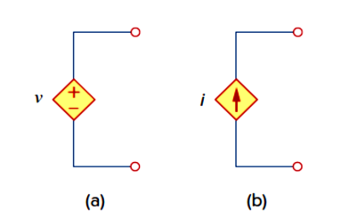
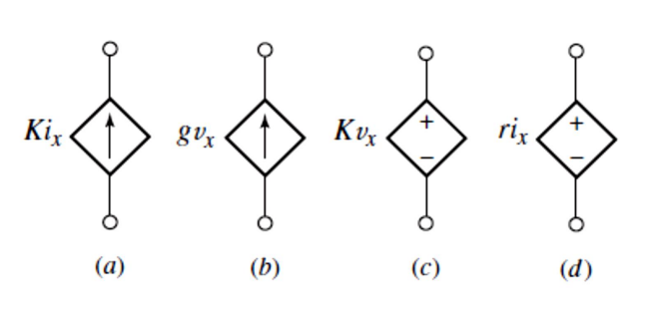

Dependent Sources
Dependent sources are useful in modelling elements such as transistors, operational amplifiers, and integrated circuits.
(a) dependent voltage source
(b) dependent current source
The four different types of dependent sources:
current-controlled current source;
voltage-controlled current source;
voltage-controlled voltage source;
current controlled voltage source.
The source on the right-hand side is a current-controlled voltage source.
Notes:
A dependent (or controlled) source is an active element where the output (voltage or current) depends on a voltage or current elsewhere in the circuit. They differ from independent sources, which provide a fixed voltage or current regardless of other circuit elements.
Dependent Voltage Source: The voltage across the source is determined by another circuit variable (either a voltage or current elsewhere).
Voltage-controlled voltage source (VCVS)
Current-controlled voltage source (CCVS)
(b) Dependent Current Source: The current through the source depends on another voltage or current in the circuit.
Current-controlled current source (CCCS)
Voltage-controlled current source (VCCS)
Dependent sources are usually designated by diamond-shaped symbols.
Voltage source comes with polarities (+ −) in its symbol, while a current source comes with an arrow, irrespective of what it depends on.

Slide 11
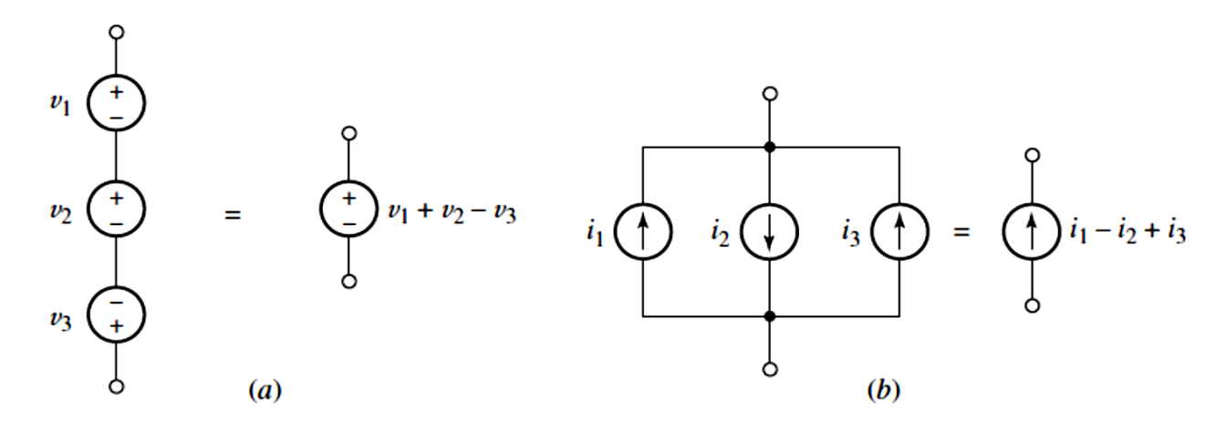
SERIES AND PARALLEL CONNECTION OF SOURCES
(a) Series-connected voltage sources can be replaced by a single source
(b) Parallel current sources can be replaced by a single source.
Notes:
SERIES AND PARALLEL CONNECTION OF SOURCES
(a) Series Connection of Voltage Sources
Voltage sources connected in series can be combined into a single equivalent voltage source. The equivalent voltage is the algebraic sum of the individual voltages. This means the total voltage across the series combination is just the sum of the individual voltages, taking into account their polarity.
(Note: Series connection is only valid for voltage sources, and the resulting equivalent source behaves like a single voltage source with the combined voltage.)
(b) Parallel Connection of Current Sources
Current sources connected in parallel can be replaced by a single equivalent current source. The equivalent current is the algebraic sum of the individual currents. This means the total current provided by the parallel combination is the sum of individual currents, accounting for their directions.
(Note: Parallel connection applies only to current sources, and the equivalent behaves like a single current source with the combined current.)

Slide 12
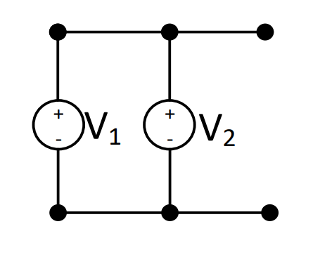
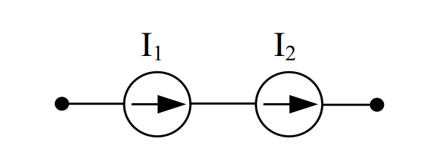
Voltage Sources in Parallel
Current Sources in Series
V₁= V₂
V₁≠ V₂
X
I₁= I₂
I₁≠ I₂
X
Two voltage sources are connected in parallel to increase current rating.
Two different current sources must not be connected in series as it violates Kirchhoff’s current law.
Two unequal voltage sources parallel connection should be avoided as it leads to circulating current among the sources
Notes:
Voltage Sources in Parallel
When two voltage sources are connected in parallel, the voltage across both sources must be the same. Two voltage sources in parallel are typically connected to increase the current rating (i.e., to supply more current to the load without increasing the voltage).
Current Sources in Series
When two current sources are connected in series, the current through both sources must be the same. Two different current sources must not be connected in series since this would force different currents through the same path, which is impossible physically.

Slide 13
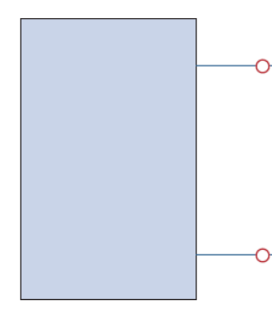





Termination
Active element
Active element
Open Circuit
Short Circuit
$$R→∞$$
$$i=0$$
$$R→0$$
$$V=0$$

Slide 14
Thank You !!!

